Slide 1


Slide 2
GUI AUTOMATION
PROFESORS (AS MENTORS):-
1)RESHMA VERMA
2)SHARMILA SUTTUR
GROUP MEMBERS:-
1)ASHISH GURRAM
2)ANURAG PALIWAL
3)SRISHTI AGRAWAL
4)KUMAR SATYAM

Slide 3

Work-let Name: GUI AUTOMATION
Worklet Details
Worklet ID:
College Name: RAMAIAH INSTITUTE OF TECHNOLOGY
Finished basics of android studio
We installed Samsung app and got familiar with its UI interface.
We were able to use UI AUTOMATOR to get dimensions of an object.
We were able to get colour codes using colour picker app.
We were not able to extract other information apart from dimensions .
KPIs achieved till now
Any Challenges/ Issues faced
Next Steps
1) We are trying to get through other parameters of elements using UI AUTOMATOR or any such similar application.
1)We haven’t any significant achievements as of now .
Key Achievements/ Outcome till now
Date: 17\11\2

Slide 4
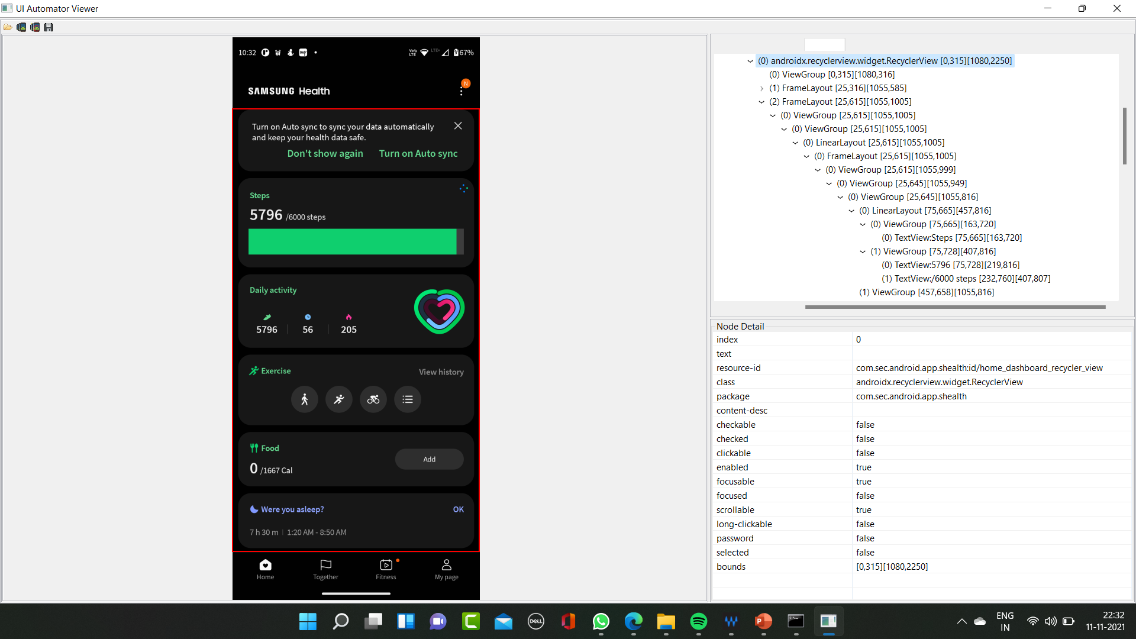
UI AUTOMATOR VIEW

Slide 5
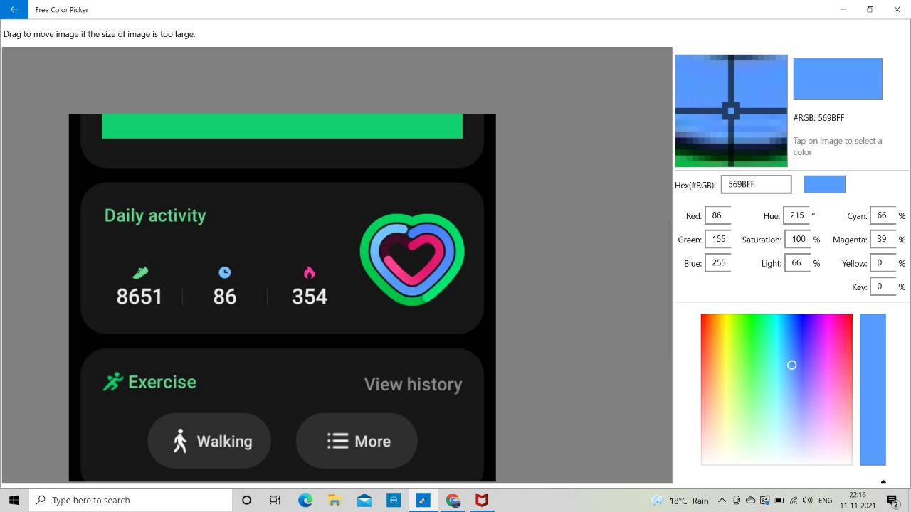
COLOR PICKER VIEW

